Slide 1
Creative Thinking Jason Leigh, Nurit Kirshenbaum
Laboratory for Advanced Visualization & Applications
Hawaiʻi Data Science Institute
Academy for Creative Media System
University of Hawaiʻi at Mānoa

Slide 2
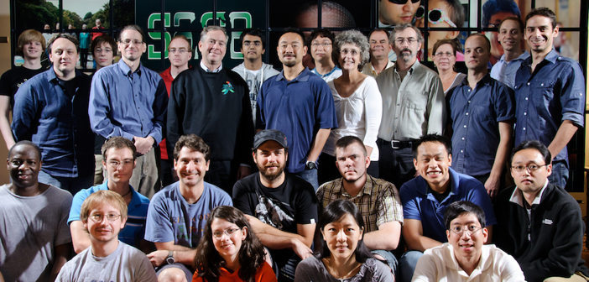
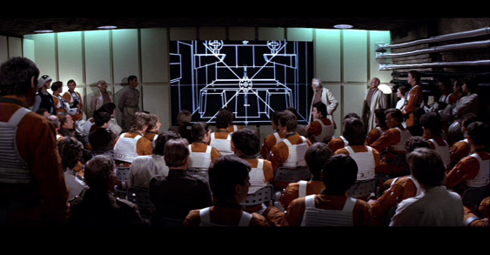
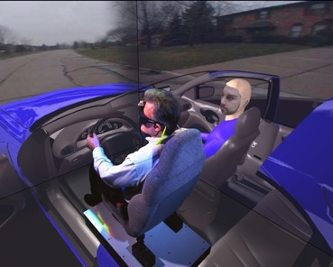
Electronic Visualization Laboratory, University of Illinois at Chicago

Slide 3
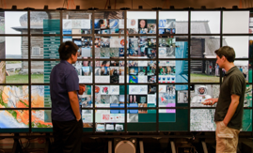


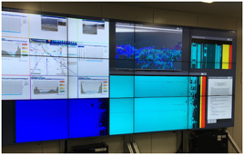
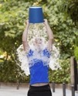

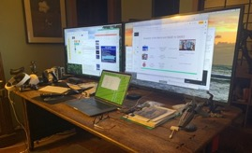


Introduction to SAGE
2004
Compute Cluster
$500K-$1M systems
Grid Computing
(C++)
2014
Single PC
$100K-$300K systems
Science Portals & Gateways
Cloud Computing
(Javascript)
2020
Data Science Notebooks, Cloud AI & Containers
NSF Cyber Ecosystem
Single Laptop - Single PC
$3K-$100K systems
(Typescript & Python)
Notes:
Combine ‘ideas’ from 8,9,10 slides→ see ‘micropscope’ Bonnington → new e-science

Slide 4
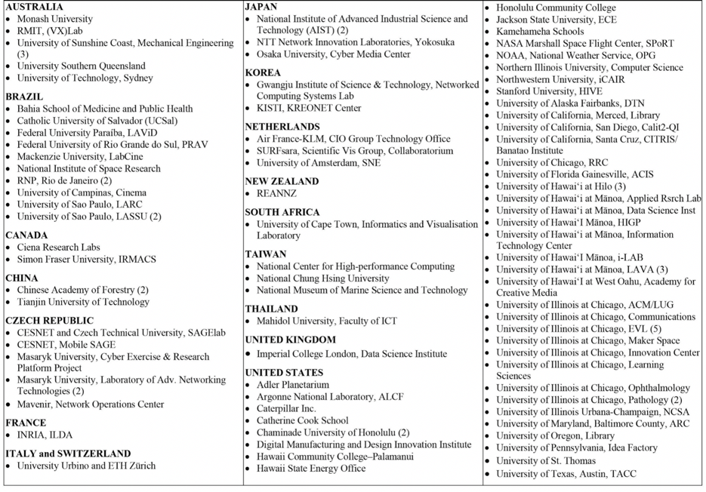
Most Recent 100 SAGE2 Walls

Slide 5
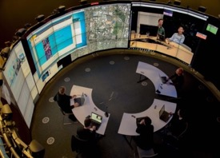
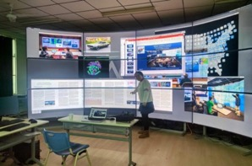
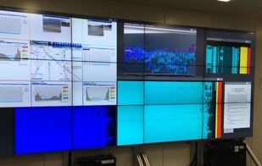
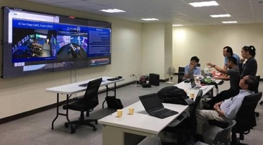
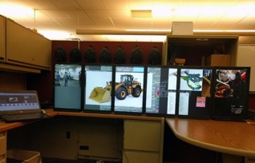
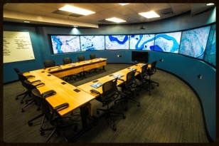
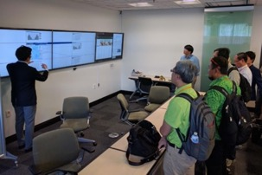
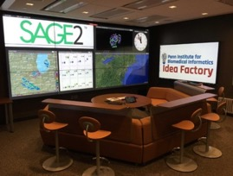
Australia, Monash Univ., Monash Immersive Visualisation Platform
China, Tianjin University of Technology
Japan, National Institute of Advanced Industrial Science and Technology (AIST)
Taiwan, National Chung Hsing University
USA, Caterpillar Inc.
USA, Univ. Alaska Fairbanks, Decision Theater North
USA, University of Florida Gainesville, ACIS
USA, Univ. Pennsylvania, Biomedical Informatics, Idea Factory

Slide 6
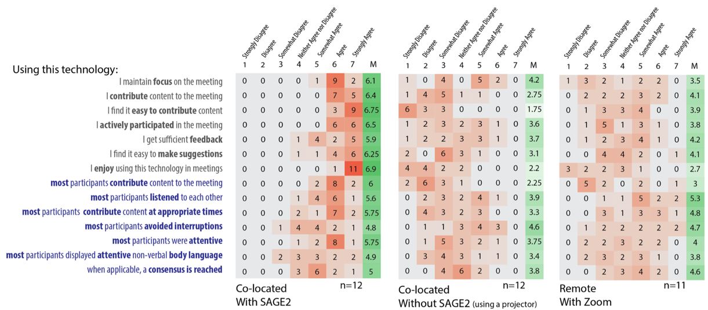
SAGE vs Classic Single Projector vs Zoom
SAGE2
Classic
Zoom

Slide 7
Let’s Try SAGE3
Login
Enter a Board
Contribute Content – picture your dog in your computer
Move Them Around, Resize them
Download Documents

Slide 8
What Does Science Say About Creativity?
Ukkola-Vuoti, L., Kanduri, C., Oikkonen, J., Buck, G., Blancher, C., Raijas, P., ... & Järvelä, I. (2013). Genome-wide copy number variation analysis in extended families and unrelated individuals characterized for musical aptitude and creativity in music, PLoS One, 8(2), e56356.
Extra copy of the Glucose Mutarotase Gene. Gene involved in the release of Serotonin- neurotransmitter that promotes neural connections. GALM increases production of serotonin & brain’s ability to use it.

Slide 9
Jung, R. E., Mead, B. S., Carrasco, J., & Flores, R. A. (2013). The structure of creative cognition in the human brain, Frontiers in human neuroscience, 7.
Forget the idea: Left is logical part of your brain, Right is creative.
Language is on the left but creativity draws on multiple interacting brain networks.
3 brain networks
Executive Attention Network depends on your working memory, and is active when you're focused on a task
Imagination Network / Default Mode Network - creates mental simulations about future events & is active when you consider other peoples thoughts or perspectives.
Salience Network - monitors your internal consciousness and events that occur outside your body so it can direct your attention to what’s most important / what is the most salient in our environment / what is most interesting to us
When all networks are active it can actually diminish creativity
Reducing executive attention network a little can boost creativity

Slide 10
Fassbender, C., Zhang, H., Buzy, W. M., Cortes, C. R., Mizuiri, D., Beckett, L., & Schweitzer, J. B. (2009). A lack of default network suppression is linked to increased distractibility in ADHD, Brain research, 1273, 114-128.
Study of ADHD in children and adults showed that people with ADHD have more active imagination networks and less execute attention network vs neurotypical.
Focused attention has been shown to limit spontaneity.
Limb, C. J., & Braun, A. R. (2008). Neural substrates of spontaneous musical performance: an FMRI study of jazz improvisation, PLoS One, 3(2), e1679.
Jazz musicians inside an fMRI machine found that when they were improvising their imagination networks were more active.
But when they just played over-learned musical sequence their executive attention network were more active.

Slide 11
Pisapia, N. et al, Brain Networks for Visual Creativity : a Functional Connectivity Study of Planning a Visual Artwork, Nature, Scientific Reports 6, Article 39185 (2016).
When planning an artwork: Found stronger connection between IN (Imagination Network) and EN (Executive Control Network), and this effect was enhanced in professional artists as compared to non-professional.
IN creates spontaneous ideas, EN approves the promising ones for further thought.
In other-words pros know how to better manage the communication between the IN and ECN to be creative and to produce useful creative ideas. They know how and when to dial up and down IN vs ECN. (more about this later)

Slide 12
Can Creativity be Trained, Honed or Taught?
Berkowitz, A. L., & Ansari, D. (2008). Generation of novel motor sequences: the neural correlates of musical improvisation, Neuroimage, 41(2), 535-543.
Pro dancers, artists, musicians were compared with novices in their fields.
During mental or active improvisational sessions like compose 5 note tune or mentally compose a drawing or mentally perform a dance, pros thought about the task differently engaging different parts of their brain than novices.

Slide 13
So How Do We Become More Creative?
The model of the 3 brain networks suggests we want to control these networks in a way that they are not competing, so we need to structure the way we create ideas so that this competition does not happen.
Treat it like learning a skill. Regular practice. Like learning to play an instrument. You can’t expect to be able to be creative to meet a deadline tomorrow, unless you’re trained with skills to do so.
Conditions
Mechanics

Slide 14
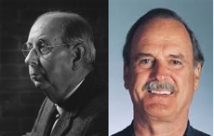
Conditions for Creativity
Based on work of Donald MacKinnon (Berkeley) & later John Cleese
Creativity is not a talent. It is a way of operating.
Creative people put themselves in a “mood” that allowed their natural creativity to function.
An ability to play and even to be childlike. In this state people are able to explore and discover, even though there may not be any immediate practical purpose to their play. Play for its own sake is the key.

Slide 15
Open & Closed Mode of Working
You can describe the way people work in these two ways.
Closed mode is the mode we are in most of the time when we are at work.
Creativity is not possible in the closed mode.
Open mode is more relaxed, less purposeful, more contemplative, and more inclined to humor.
The open mode is more playful and curiosity can operate for its own sake since there is less pressure to get to a particular goal quickly.
Play allows our natural creativity to surface.

Slide 16
Conditions Necessary to be More Creative
Space
Cannot be creative in your “work” environment since there you are focused on getting the job done. You are in closed mode. You need a space that gets you away from that.
Time
Creative time must be scheduled (90 minutes) – a specific start time and end time. Otherwise it is too easy to drift back to work mode.
Must not use the Space/Time Oasis to sneak back to get work done.
Deferring Decisions
More creative people are willing to tolerate the discomfort of not solving the problem quickly in order that they may discover a much better and more original solution.
Deferring decisions makes people in meetings uncomfortable (especially in a results driven world) and has to be overcome in order for creativity to happen.

Slide 17
Confidence
You need confidence to be free to play. Open to trying anything without fear of it not working.
You cannot be playful if you are frightened of being wrong.
In your creative oasis you play with ideas, you do not judge them.
Humor
Humor gets us from closed mode to open mode faster than anything else.
Laughter creates relaxation & humor widens our perspective.
Do not confuse being serious with being solemn. Laughter does not make what you are working on less serious.

Slide 18
When the creative “work” is done and you now have to implement the decisions, being creative is bad. Now it’s time for the Closed Mode.
But after implementation and you are reviewing the feedback, open mode is good again.

Slide 19

Importance of Collaboration
Steven Johnson – American popular science author & media theorist
“Where Good Ideas Come From”
Myth of the brilliant individual in a Eureka Moment.
There is a long gestation period before a good idea emerges.
It comes from random collisions with other ideas from other people over long periods of time.
https://www.youtube.com/watch?v=NugRZGDbPFU

Slide 20
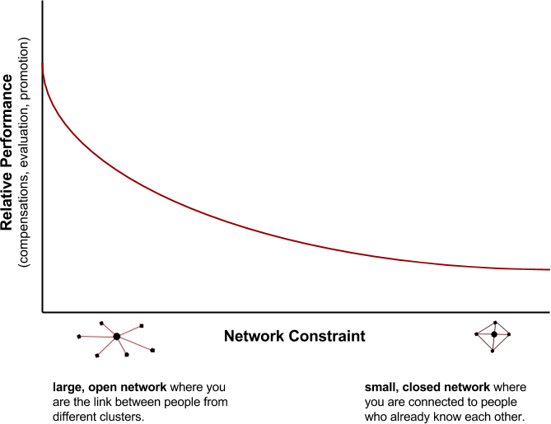
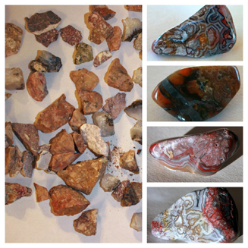
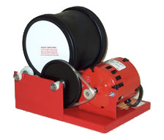
Single Variable That Explains What Really Causes Career Success
Ron Burt – University of Chicago Booth School of Business

Slide 21
Mechanics
Disney Animators – fast and furious sketching.
Pick the medium you are most comfortable with getting the most ideas out as fast as possible – paper, typing, drawing, postits etc.
It cannot just be thinking to yourself. Your working memory can only hold ~7 things at a time.
There are many possible methods.
First time you do these you will feel subconscious & it may not be rewarding.
It takes practice to figure out which methods work best for you.
Brainstorm on your own first, then bring your ideas to a meeting.

Slide 22
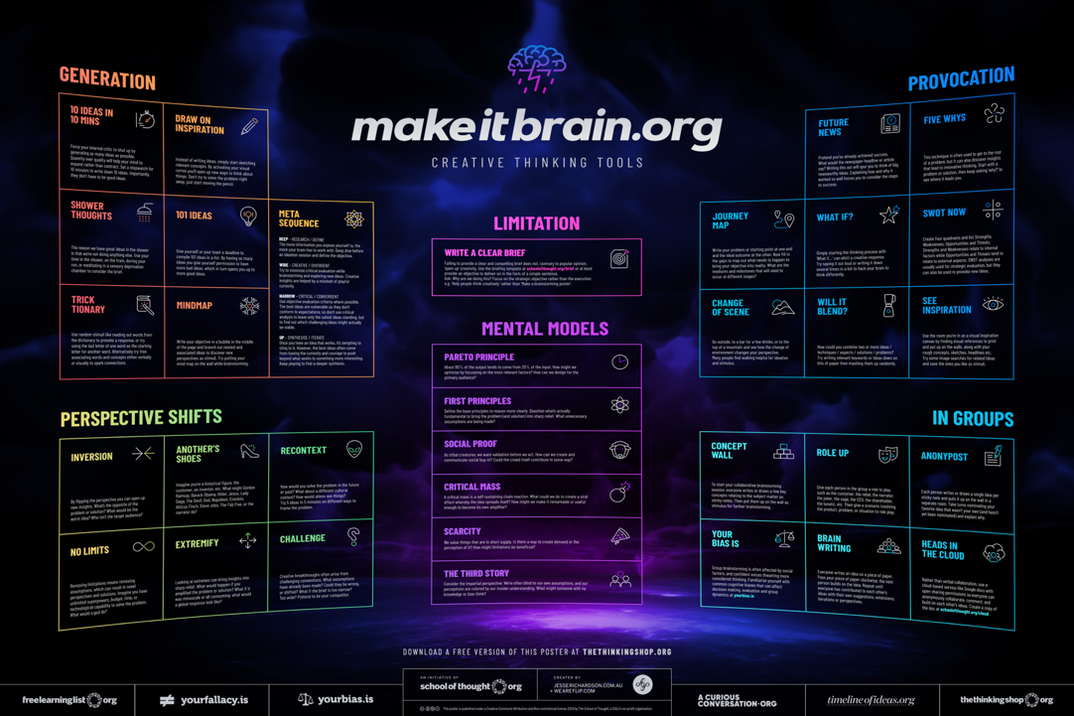

Slide 23
Very SAGEable Methods
Open Mode Mantra
Concept Wall
10 ideas in 10 mins
101 ideas – allow more flexibility to give bad ideas
Blend ideas
See Inspiration (post pictures)
Bias – we love our own ideas; don’t let confident voices drown others out
Anonymous post
Write an idea and pass it to next person to add (6 people, 3 ideas, 5 minutes)
Use a collaborative cloud service (like SAGE3 ☺)
Quantity over quality
Don’t judge any ideas
Encourage wild ideas
Build on the ideas of others
Work independently at first

Slide 24
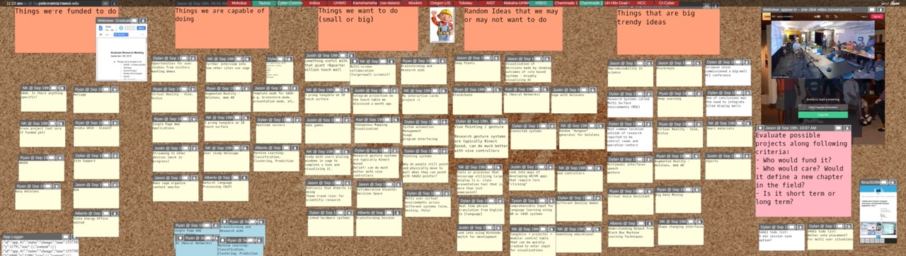
101 Ideas – Persistent Evolving Idea Board
Present
Past
Future
Ideas from Within
Ideas from Without

Slide 25
101 Ideas / See Inspiration – BMW Wall of Inspiration

Slide 26
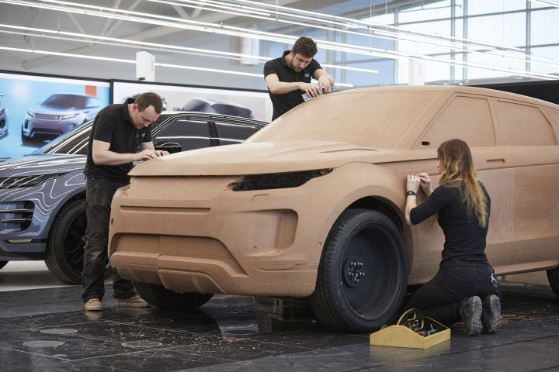
Persistent Evolving Ideas

Slide 27
See Inspiration
https://miro.com/app/board/o9J_kpCBBfc=/

Slide 28
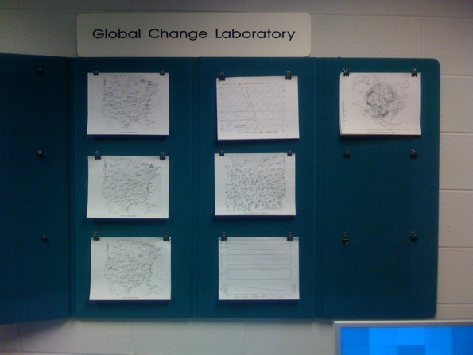
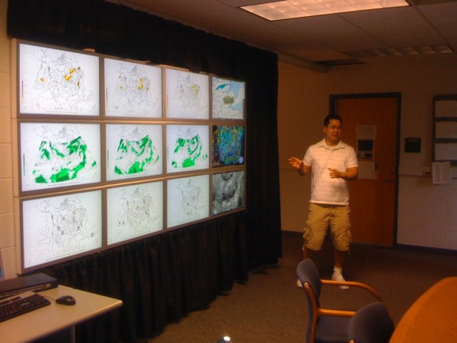
University of Michigan Atmospheric Sciences Department

Slide 29
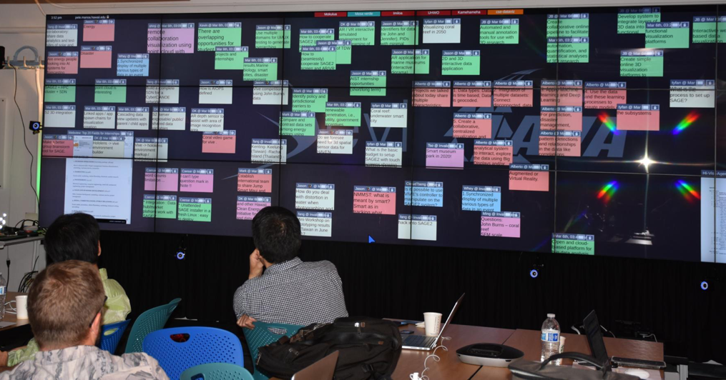
Bias - don’t let confident voices drown others out

Slide 30
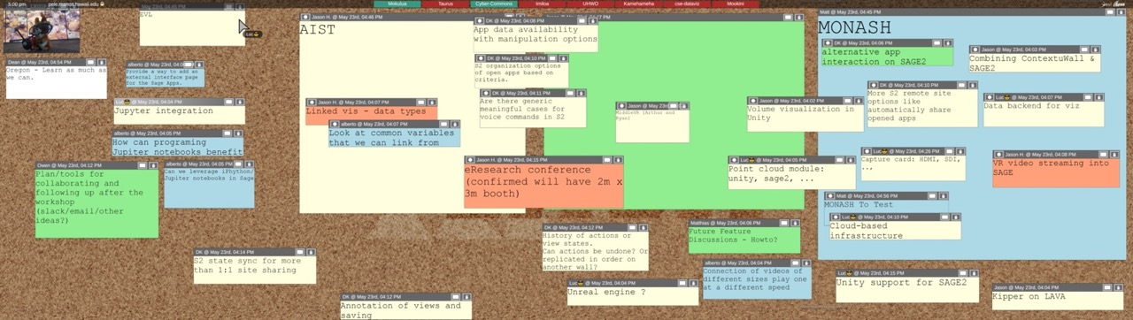
Blend Ideas

Slide 31
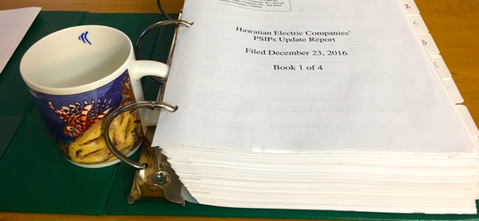
Blend Ideas - HAVEN

Slide 32
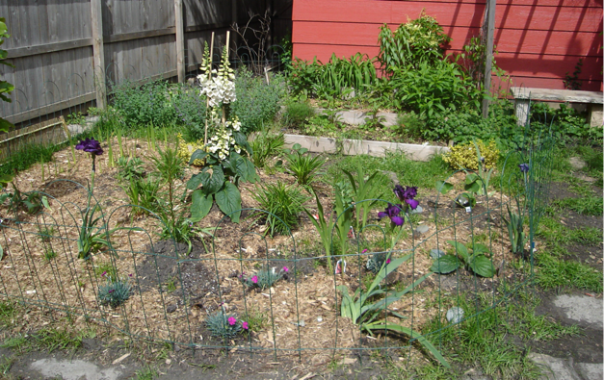
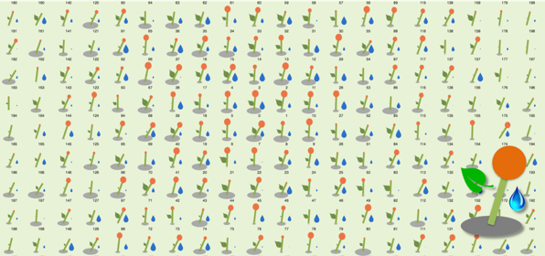
Blend Ideas – HAVEN – Energy Portfolio Garden

Slide 33


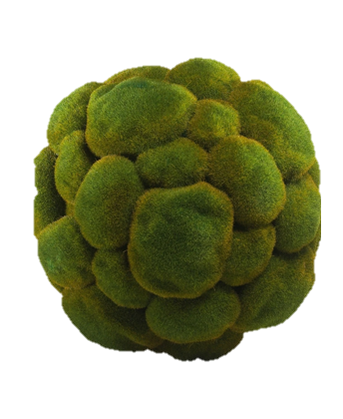

Brainstorm Topic
Hawaiʻi Museum of Science and Stuff – HI-MOSS
You are tasked with designing this museum.
Come up with ideas for what exhibits to put into it.

Slide 34
Consolidate
Combine Ideas
Identify Ideas You Like / Vote
Group ideas- which floors will have which exhibits?

Slide 35
Future Brainstorm Topic: The CyberClub
CyberClub Community of Practice in Data Science & Cyberinfrastructure
Graduate Fellows as mentors and ‘cyber ambassadors’ to undergraduates across departments

Slide 36
URLs
SAGE3 Support
tinyurl.com/sagecommunity
CyberClub
tinyurl.com/hawaiidatascienceclub

